Slide 1

Is Precision Medicine Possible?

Slide 2

WHY: currently, the medical system is focused on treatment to the exclusion of prevention; moreover existing treatments depend on diagnostic methods that do not fully leverage the advances in analytic technology and algorithm development. These advances can enable precision medicine at the individual level for both proactive and reactive medicine BUT…: we can’t boil the ocean for this project (give me 10bn and maybe then…) but we can demonstrate the possibility of precision medicine by attempting to solve for a smaller problem: medical diagnoses. Now the question becomes…

Slide 3

Can we build a
recommendation engine
for medical diagnoses?

Slide 4

Where are the data? https://www.cms.gov/Research-Statistics-Data-and-Systems/Statistics-Trends-and-Reports/BSAPUFS/Outpatient_Proc.html
About the data
Outpatient Procedures for Public Use from the Centers for Medicare & Medicaid Services
At the procedure level only. Patient level not available
31,701,499 procedures in the file
Only available for 2008 (published in 2011)

Slide 5
About The Data
31m rows means my machine doesn’t handle it well
Makes visualizing and exploration difficult
Fortunately the documentation that accompanies this data and Tableau will help with this exploration

Slide 6
About The Data cont’d
3 separate csv files
31,701,499 total rows
27.13 procedures per individual
No missing data (yay!)
Column Name | Description
OP_PROC_ID | Encrypted procedure-level file, each row on the file has a unique value for OP_PROC_ID
BENE_SEX_IDENT_CD | Sex of the beneficiary, 1 = male, 2 = female
OP_CLM_ICD9_DIAG_CD | This variable indicates the primary International Classification of Diseases, version 9, Clinical Modification associated with the claim.
OP_HCPCS_CD | HCPCS (Healthcare Common Procedure Coding System) codes to identify items and procedures
OP_HCPCS_UNIT_CNT | This variable provides the count of units/services of a particular procedure (identified by the HCPCS code) that was performed.
OP_HCPCS_PMT_AMT | Payment made by Medicare for the procedure.
BENE_AGE_CAT_CD | Beneficiary's age category at end of the reference year (2008)

Slide 7
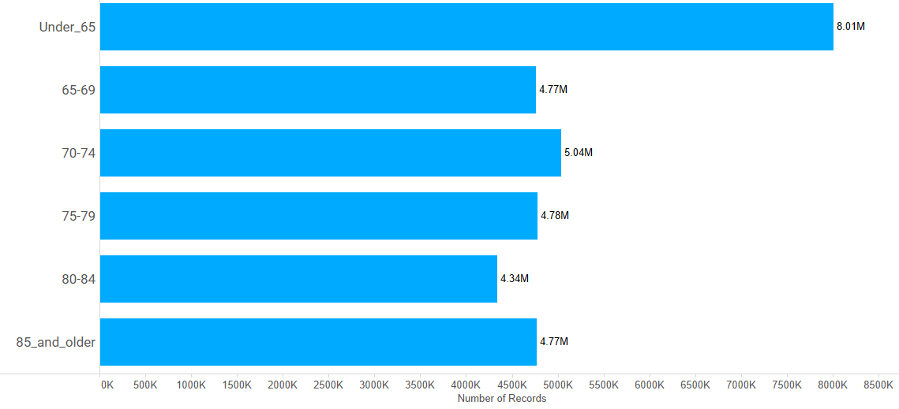
About The Data cont’d
Given eligibility requirements, most procedures are provided for people 65 years and older
Notes:
Note: more exact ages are not available
https://medicare.oneexchange.com/medicare/medicare-eligibility

Slide 8
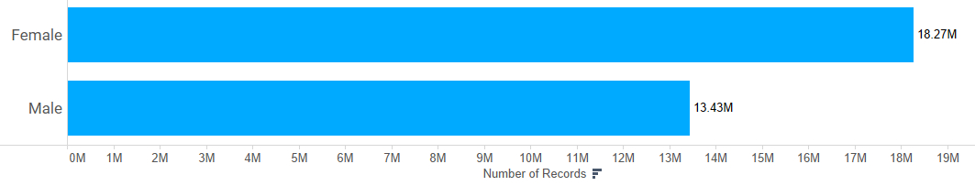
About The Data cont’d
Majority of the procedure recipients are female
Notes:
Note: more exact ages are not available

Slide 9
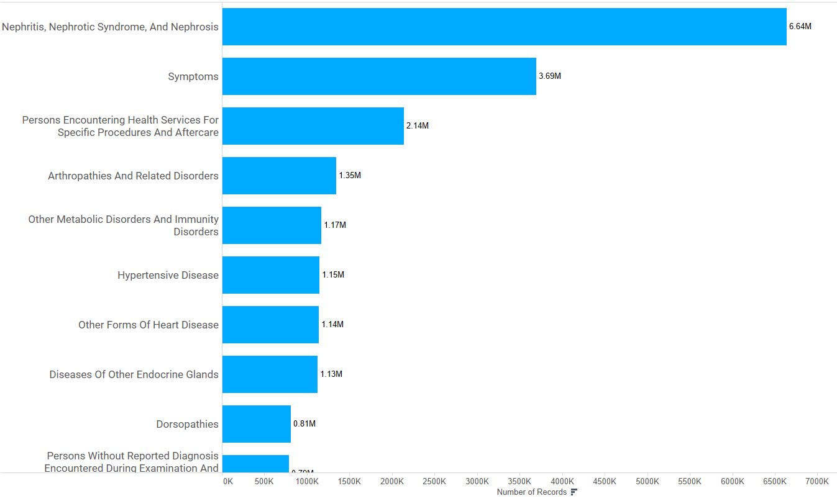
About The Data cont’d
Most procedures focus on kidney procedures, this makes sense given age and eligibility requirements (kidney failure is a medicare qualifier)
Notes:
Note: more exact ages are not available

Slide 10
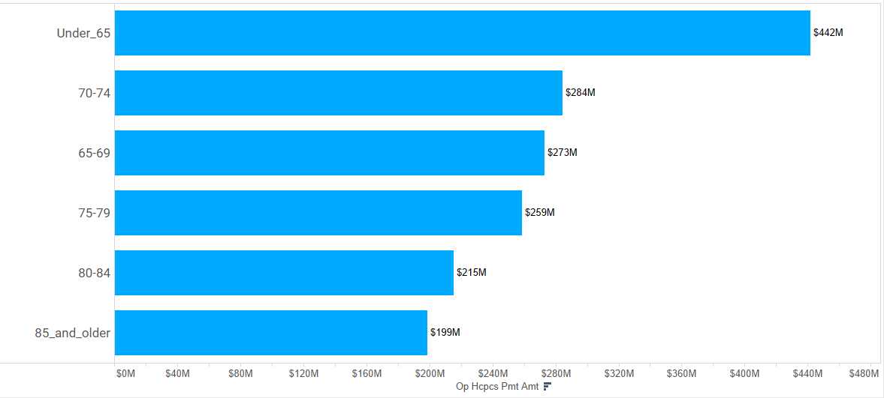
About The Data cont’d
Most costly procedures are administered to 65 and younger, again not surprising given eligibility requirements

Slide 11
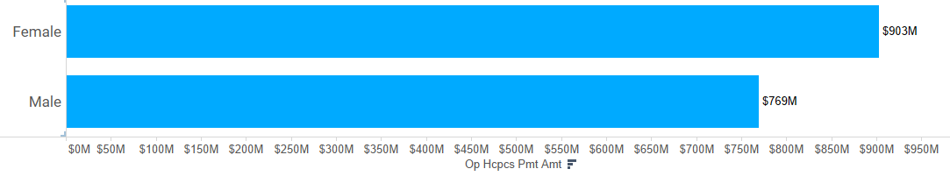
About The Data cont’d
Procedures administered to women appear to be more costly, but this is likely due to women making up a larger portion of this sample, rather than the procedures themselves being more costly

Slide 12
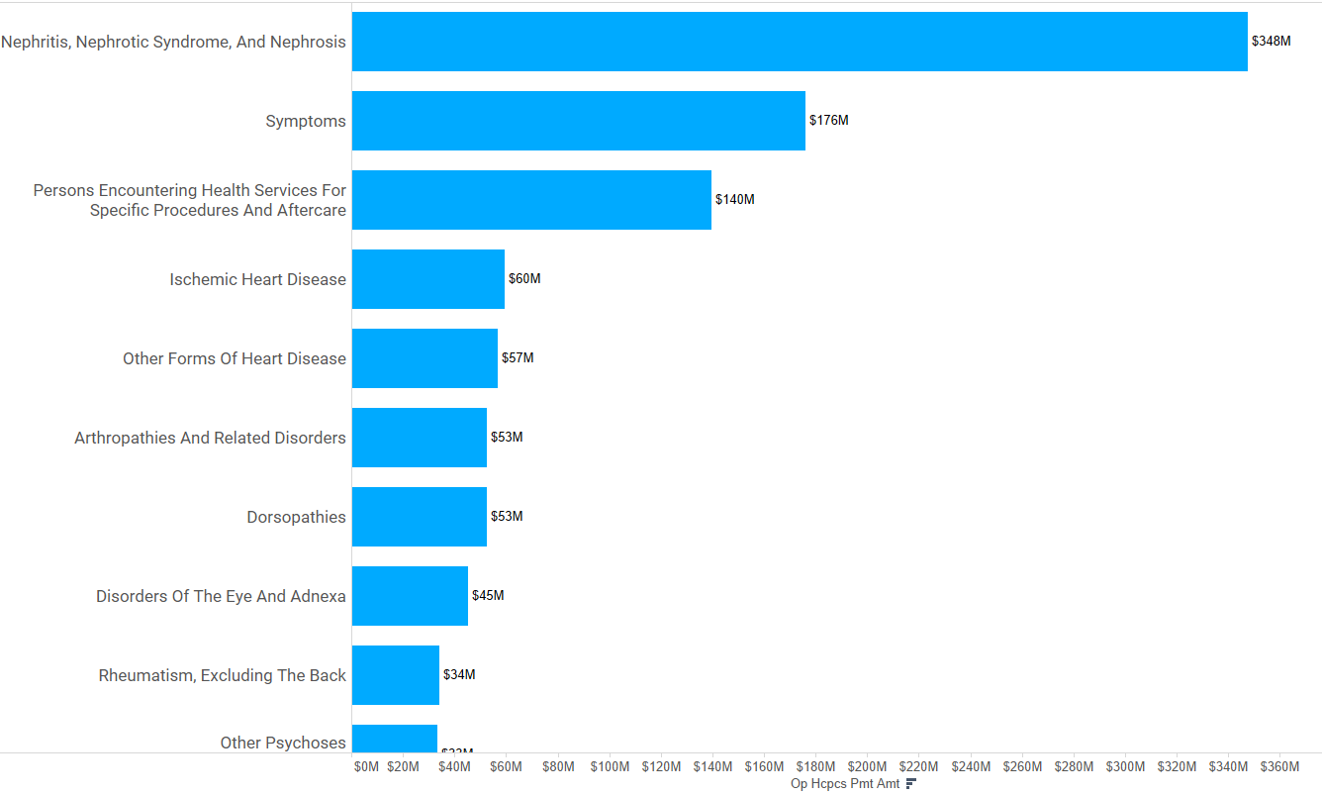
About The Data cont’d
Kidney procedures are the most expensive, followed by general symptoms

Slide 13
Key tasks
Data access, cleaning, and exploration
Download files (done!)
Merge 3 files into single large csv (done!)
Data exploration and profiling (done!)
Simulate individual patients by creating a fake patient_id column (pending)
Model exploration, building, and testing
Research existing python recommendation engine modules (pending)
Choose module (pending)
Explore module (pending)
Test model (pending)

Slide 14

WHY?: I really want to play with building a recommendation engine and… I believe precision medicine is the future of medicine

